Slide 1
TEXTUAL ANALYSIS IN SOFTWARE PROJECTS
PRESENTED BY:
SOURISH ROY

Slide 2
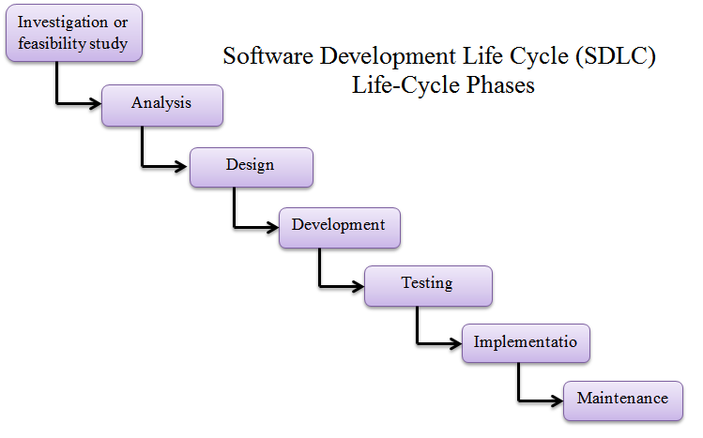
Most of the data in Software Projects is of textual nature.
Let’s analyze System Development lifecycle for textual data.

Slide 3
Now the question arises.. How to make use of all these textual data?
TEXT MINING/ TEXT ANALYTICS:
It refers to the process of deriving high-quality information from text.
Text mining usually involves the process of structuring the input text deriving patterns within the structured data and finally evaluation and interpretation of the output.

Slide 4
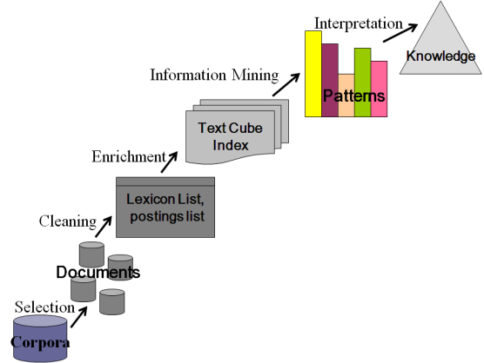
Text Analysis process:

Slide 5
Sources of Textual data
Formal and Semiformal comments
Inline Comments
Developers
Test Results
Descriptions of Interfaces or classes
Test cases
Source code
Testers
Requirement spec document
Review Results
Requirement Engineers
Feasibility report

Slide 6
Are we missing something?
Communication between team members
Emails, Chats,
change requests, commit messages
Team member 1
Team member 2
Customer surveys
Product reviews

Slide 7
Text Retrieval …
Text retrieval is concerned with the organization and retrieval of textual information from a large number of text-based documents
Only a small fraction of the many available Documents will be relevant to a given individual use.
There exist many information retrieval systems, such as on-line library catalog systems, on-line document management systems, and the more recently developed Web search engines.

Slide 8

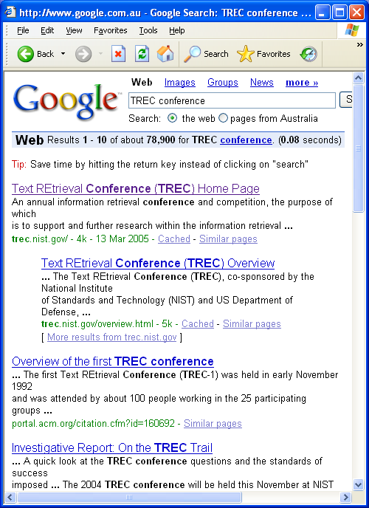
Example
Google
Web

Slide 9
Text Retrieval continued…
Relevant documents
Retrieved documents
Relevant & Retrieved documents

Slide 10
Text Indexing
When the number of documents to search is potentially large, problem of full-text search is often divided into two tasks: indexing and searching
The indexing stage will scan the text of all the documents and build a list of search terms
In the search stage, when performing a specific query, only the index is referenced, rather than the text of the original documents
Some indexers also employ language-specific stemming on the words being indexed. For example, the words "drives", "drove", and "driven" will be recorded in the index under the single concept word "drive."

Slide 11
Information Extraction
It involves directly with the text mining process by extracting useful information from texts
IE deals with the extraction of specified entities, events and relationships from unrestricted text sources
IE can be described as creation of the structured representation of selected information drawn from texts.

Slide 12
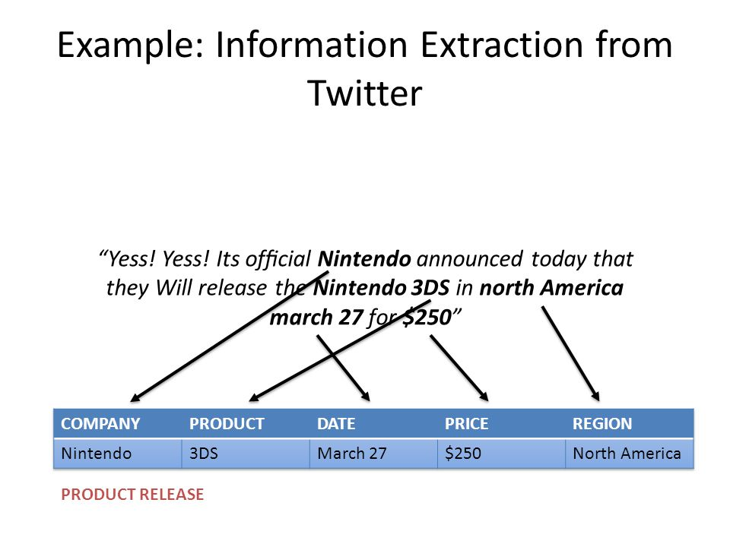

Slide 13
Natural Language Processing
NLP is a technology that concerns with natural language generation (NLG) and natural language understanding (NLU)
NLG uses some level of underlying linguistic representation of text, to make sure that the generated text is grammatically correct and fluent

Slide 14
NLU is a system that computes the meaning representation, essentially restricting the discussion to the domain of computational linguistics
NLU consists of at least one of the following components: tokenization, morphological or lexical analysis, syntactic analysis and semantic analysis
In tokenization, a sentence is segmented into a list of tokens. The token represents a word or a special symbol such an exclamation mark
Morphological or lexical analysis is a process where each word is tagged with its part of speech.

Slide 15
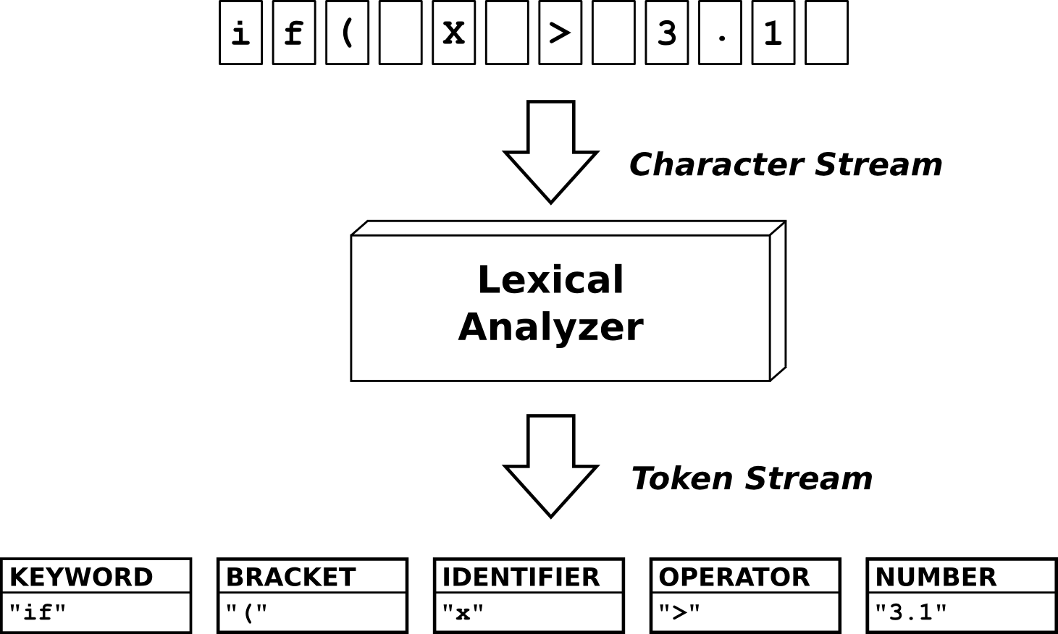
A small example of the lexical analyzer in Compiler theory

Slide 16
Manual Coding
Structures and classifies the textual data
Identify patterns in texts
Coding process depends on experiences, views and interpretations to analyze data and build hierarchy of codes
Assigns meaning to statements and events

Slide 17
Basic steps of Coding Process
Open Coding: Basically, you read through your data several times and then start to create tentative labels for chunks of data that summarize what you see happening
Axial Coding: Axial coding consists of identifying relationships among the open codes. What are the connections among the codes?
Selective Coding: Figure out the core variable that includes all of the data. Then reread the transcripts and selectively code any data that relates to the core variable you identified
Validation: Aims at confirming the model developed with the authors of the original textual data

Slide 18
What is a text corpus?
Corpus is a large collection of texts. It is a body of written spoken material upon which a linguistic analysis is based.
WHAT IS THE USE OF CORPUS?
Better descriptions of a language.
Computer-process able corpora allow linguists to adopt the principle of total accountability, retrieving all the occurrences of a particular word or structure for inspection or randomly selected samples.
Corpus analysis provide lexical information, morphosyntactic information, semantic information and pragmatic information.
Linguistic information is provided by concordance and frequency counts.

Slide 19
Automated Analysis
Automated software engineering applies computation to software engineering activities.
The goal is to partially or fully automate these activities, thereby significantly increasing both quality and productivity.
This includes the study of techniques for constructing, understanding, adapting and modelling both software artifacts and processes.
Automatic and collaborative systems are both important areas of automated software engineering, as are computational models of human software engineering activities.
Examples: Knowledge representations and artificial intelligence

Slide 20
Topic Modelling

Slide 21
What is Topic Modelling? Topic modelling is a form of text mining, a way of identifying patterns in a corpus. You take your corpus and run it through a tool which groups words across the corpus into ‘topics’.
How does it work?
One way to think about how the process of topic modelling works is to imagine working through an article with a set of highlighters. As you read through the article, you use a different color for the key words of themes within the paper as you come across them. When you were done, you could copy out the words as grouped by the color you assigned them. That list of words is a topic, and each color represents a different topic.
USEFUL TOOL: MALLET is particularly useful for those who are comfortable working in the command line, and it takes care of tokenizing and stopwords for you.

Slide 22
Part-of-speech Tagging/ Relationship Extraction
Part of Speech (pos) tagging is the problem of assigning each word in a sentence the part of speech that it assumes in that sentence.
Input: a string of words + a tagset
Output: a single best tag for each word
Tagging makes parsing easier

Slide 23
Word Classes
Words that somehow ‘behave’ alike:
Appear in similar contexts
Perform similar functions in sentences
Undergo similar transformations
~9 traditional word classes of parts of speech
Noun, verb, adjective, preposition, adverb, article, interjection, pronoun, conjunction

Slide 24
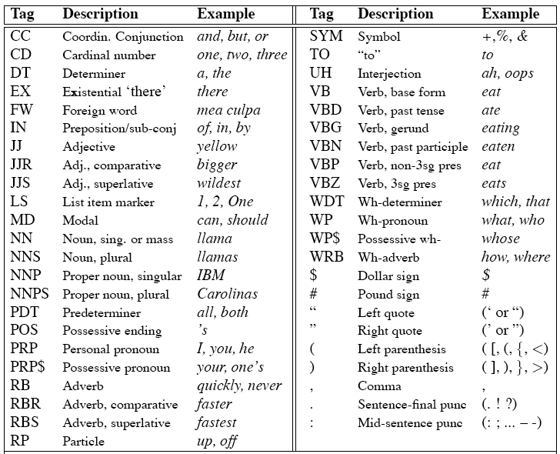
Penn Treebank Tagset

Slide 25
Using the Penn Treebank Tags
The grand jury commented on a number of other topics.
After POS tagging
The/DT grand/JJ jury/NN commmented/VBD on/IN a/DT number/NN of/IN other/JJ topics/NNS ./
Once performed by hand, POS tagging is now done in the context of computational linguistics, using algorithms which associate discrete terms, as well as hidden parts of speech, in accordance with a set of descriptive tags. POS-tagging algorithms fall into two distinctive groups: rule-based and stochastic. E. Brill's tagger, one of the first and most widely used English POS-taggers, employs rule-based algorithms.

Slide 26
N-Gram Models of Language
Use the previous N-1 words in a sequence to predict the next word
Language Model (LM)
unigrams, bigrams, trigrams,…
How do we train these models?
Very large corpora (Plural of corpus)

Slide 27
Predicting a Word Sequence (An example of Bigram)
The probability of “The cat is on the mat ” is
P(the cat is on the mat) = P(the | <s>) 
P(cat | <s> the) 
P(is | <s> the cat) 
P(on | <s> the cat is) 
P(the | <s> the cat is on) 
P(mat | <s> the cat is on the) 
P(</s> | <s> the cat is on the mat)
where the tags <s> and </s> indicate beginning and end of the sentence.
But that is not a practical solution. Instead taking only two previous tokens,
P(the cat is on the mat) = P(the | <s>) 
P(cat | <s> the) 
P(is | the cat) 
P(on | cat is) 
P(the | is on) 
P(mat | on the) 
P(</s> | the mat)

Slide 28
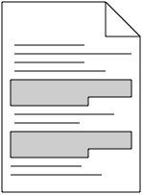
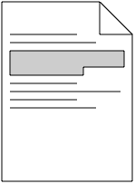
CODE CLONES
What are “Code Clones”?
A code fragment which has identical or similar code fragment (s) in source code
Clone Pair
Clone Class

Slide 29
Mutation Operators for Cloning
For each of the fine-grained clone types of the clone taxonomy,
There exists mutation operators for cloning
We are referring to the TXL [Cordy SCP’06] in implementing the operators
Tested with
C, C# and Java
Notes:
This is a note this to check

Slide 30
Mutation Operators for Cloning
For Type I Clones
Name | Random Editing Activities
mCW | Changes in whitespace
mCC | Changes in comments
mCF | Changes in formatting

Slide 31
mCC: Changes in Comments
Line Original Mutated Line
1
2
3
4
5
6
7
8
if (x==5)
{
a=1;
}
else
{
a=0;
}
if (x==5)
{
a=1;
}
else //C
{
a=0;
}
1
2
3
4
5
6
7
8
mCC

Slide 32
mCF: Changes in formatting
Line Original Mutated Line
1
2
3
4
5
6
7
8
if (x==5)
{
a=1;
}
else
{
a=0;
}
if (x==5) {
a=1;
}
else {
a=0;
}
1
2
3
4
5
6
7
8
mCF

Slide 33
mCF: Changes in formatting
Line Original Mutated Line
1
2
3
4
5
6
7
8
if (x==5)
{
a=1;
}
else
{
a=0;
}
if (x==5) {
a=1;
}
else {
a=0;
}
1
2
3
4
5
6
7
8
mCF
One or more changes can be made at a time

Slide 34
Mutation Operators for Cloning
For Type II Clones
Name | Random Editing Activities
mSRI | Systematic renaming of identifiers
mARI | Arbitrary renaming of identifiers
mRPE | Replacement of identifiers with expressions (systematically/non-systematically)

Slide 35
Mutation Operators for Cloning
For Type III Clones
Name | Random Editing Activities
mSIL | Small insertions within a line
mSDL | Small deletions within a line
mILs | Insertions of one or more lines
mDLs | Deletions of one or more lines
mMLs | Modifications of whole line(s)

Slide 36
Mutation Operators for Cloning
For Type IV Clones
Name | Random Editing Activities
mRDs | Reordering of declaration statements
mROS | Reordering of other statements (Data-dependent and/or in-dependent statements)
mCR | Replacing one type of control by another

Slide 37
Mutation Operators for Cloning
Combinations of mutation operators
if (x==5)
{
a=1;
}
else
{
a=0;
}
if (x==5)
{
a=1;
}
else //c
{
a=0;
}
if (x==5)
{
b=1;
}
else //c
{
b=0;
}
if (x==5)
{
b=1+x;
}
else //c
{
b=0;
}
mCC
mSRI
mSIL
Original Final Mutated
mCC + mSRI + mSIL

Slide 38
Visualization
A picture is worth thousand words
Graphical Visualization can help strongly in understanding the results of text analysis
Used to visualize the distribution of all kinds of metrics over files
ER diagrams shows the domain concepts in a text
Visual Analytics
Visualizing unstructured textual data

Slide 39

Word Cloud/tag crowd or wordle:
The idea is to extract the most frequent words and show them together with size of each word in relation to its frequency

Slide 40
Phrase Net and Temporal Change:
adds a bit more semantics
Along with frequent words, also present their relationship to other frequent words
The arrow becomes thicker the more frequently the relationship occurs in a text

Slide 41
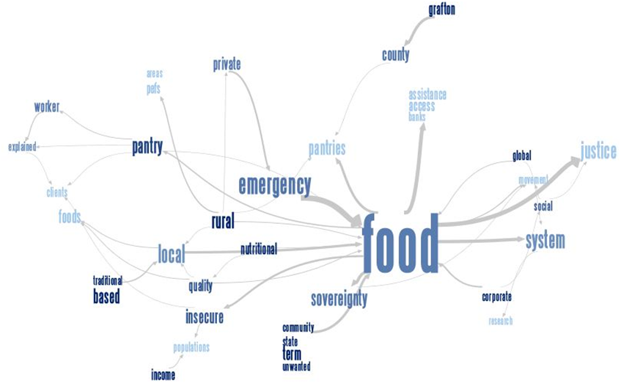
Phrase net for Food System

Slide 42
Temporal Change:
1996
1997
1998
1999
Response
Request
Header
A Text Flow Sketch of the different HTTP RFCs over time

Slide 43
REFERENCES
[1]The Art and Science of Analyzing Software Data
[2] Hsinchun Chen, “Knowledge Management Systems: A Text Mining Perspective”, Knowledge Computing Corporation, 2001
[3] Ronen Feldman and Ido Dagan. “Knowledge discovery in
textual databases (KDT)”, Knowledge Discovery and Data
Mining (1995), 112-117
[4] C. J. van Rijsbergen. 1979. Information Retrieval. 2nd ed. London: Butterworths, chapter 6

Slide 44


